Slide 1

iControl Standard PANEL for LINEAR
DESIGNED, TESTED AND VERIFIED TO FIT ALL YOUR NEEDS …

Slide 2
HOW RUNS THE
iCONTROL STANDARD PANEL ?
(Common schematic for pivot and linear.)

Slide 3
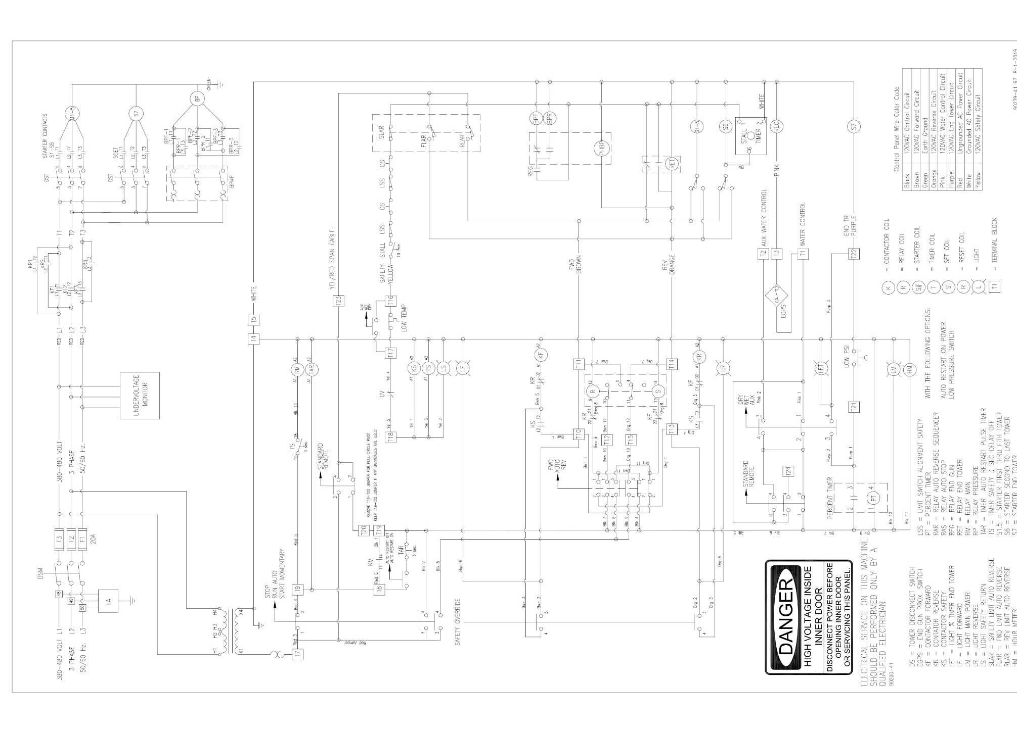

Slide 4
POWER

Slide 6
START

Slide 15
SAFETY OK

Slide 20
RUNNING

Slide 24
SPECIFIC MODIFICATIONS FOR LINEAR SYSTEMS

Slide 25

End Feed Linear
Free Standing Span
Towers installed on
the opposite side. Motors must rotate the opposite sense.
Cart
On the cable coming from cart: interchange Brown with Orange wires.
(It can be done at main panel instead of 1st Tower)
On the cable going to the end: interchange Brown with Orange wires and interchange 2 Phase wires.

Slide 26
End Feed Linear
Free Standing Span
Main panel
Reverse
Reverse
Cart
Forward
Forward
On the cable coming from cart: interchange Brown with Orange wires.
(It can be done at main panel instead of 1st Tower)
On the cable going to the end: interchange Brown with Orange wires and interchange 2 Phase wires.

Slide 27
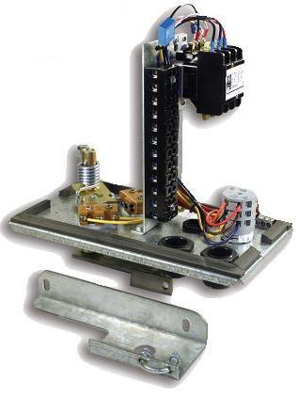
End Feed Linear
1st Tower of
Freestanding Span
Cart
1st Tower
Intermediate Towers
Main panel

Slide 28
Center Feed Linear
Free Standing Span
All towers on side B (including cart) must run with motors rotating on the opposite sense.
Side B
Side A
Cart
Connect cart tower box with Side B span cable.
At cart tower box, on cable coming from main panel, interchange Brown with Orange wires and interchange 2 Phase wires.
(It can be done at main panel instead of Cart Tower Box)

Slide 29
Center Feed Linear
Free Standing Span
Side B
Side A
Main panel
Reverse
Reverse
Forward
Forward
Cart
Connect cart tower box with Side B span cable.
At cart tower box, on cable coming from main panel, interchange Brown with Orange wires and interchange 2 Phase wires.
(It can be done at main panel instead of Cart Tower Box)

Slide 30
Center Feed Linear
2nd Tower of
Freestanding Span
Towers Side B
Cart tower Box
Main panel

Slide 31
GUIDANCE BOXES

Slide 32
End Feed Linear
Reverse Guidance Box
Reverse
Cart
Forward Guidance Box
Forward
Free Standing Span
Center Feed Linear
Reverse Guidance Box
Reverse
Forward Guidance Box
Forward
Cart

Slide 33
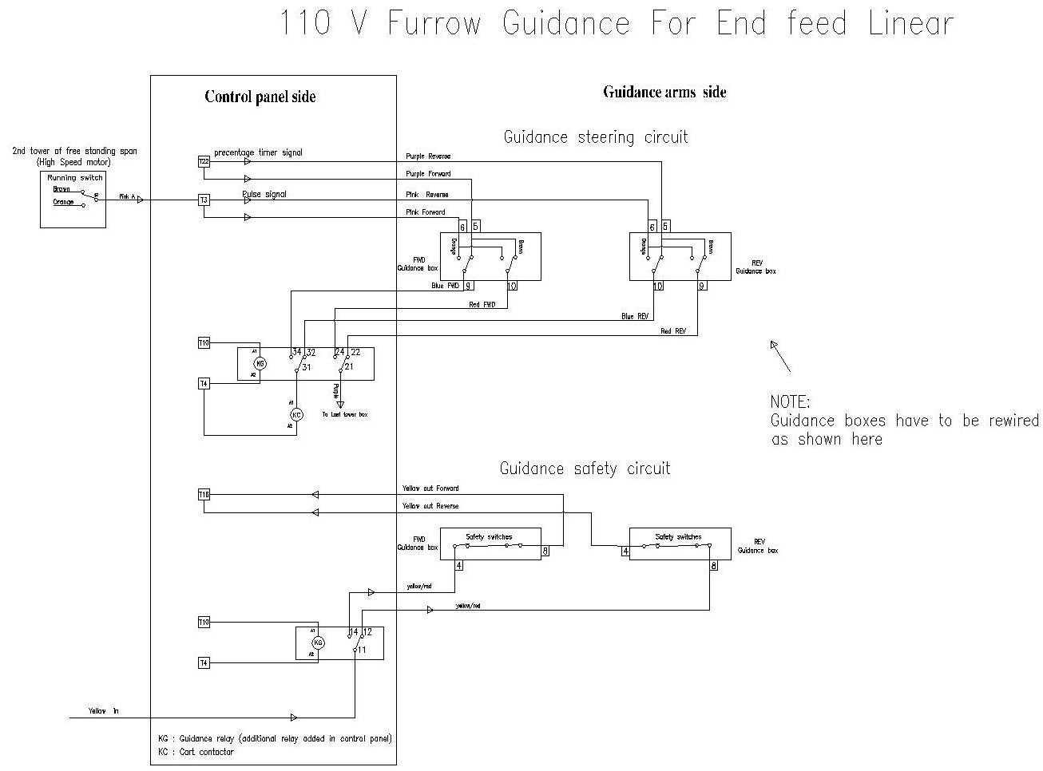

Slide 34
Panel Terminals
Forward Guidance Box
Reverse Guidance Box
KC: Cart Contactor
KG: Guidance
Selector Relay

Slide 35
Reverse Guidance Box
Reverse 0 Volt

Slide 36
Forward Guidance Box
Forward 110 Volt

Slide 37
Guidance Continuity

Slide 39
Last Tower
Cart
Guidance logic

Slide 40
Last Tower
Cart
Guidance logic
Guidance Safety

Slide 41
Reverse Guidance Box
Reverse 0 Volt
KG: Guidance
Selector Relay

Slide 42
Reverse 0 Volt

Slide 43
%T = 50%
%T = 50%
34RPM
44RPM
68RPM
34RPM

Slide 44
Forward Guidance Box
Forward 110 Volt
KG: Guidance
Selector Relay

Slide 45
Forward 110 Volt
KG: Guidance
Selector Relay

Slide 46
%T = 50%
Pulse Signal
%T = 50%
34RPM
44RPM
68RPM
34RPM

Slide 49
Pulse Signal
%T = 50%
%T = 50%
%T = 50%
34RPM
44RPM
68RPM
34RPM

Slide 50
Pulse Signal
%T = 50%
Pulse ≅ 10%
%T = 50%
%T = 50%
34RPM
44RPM
68RPM
34RPM

Slide 53
Pulse ≅ 20%
%T = 50%
%T = 50%
Pulse ≅ 10%
%T = 50%
%T = 50%
34RPM
44RPM
68RPM
34RPM

Slide 55
CENTER FEED

Slide 56
Pulse ≅ 20%
%T = 50%
Side B
Side A
%T = 50%
Pulse ≅ 10%
%T = 50%
Pulse Signal
%T = 50%
34RPM
44RPM
68RPM
34RPM

Slide 57
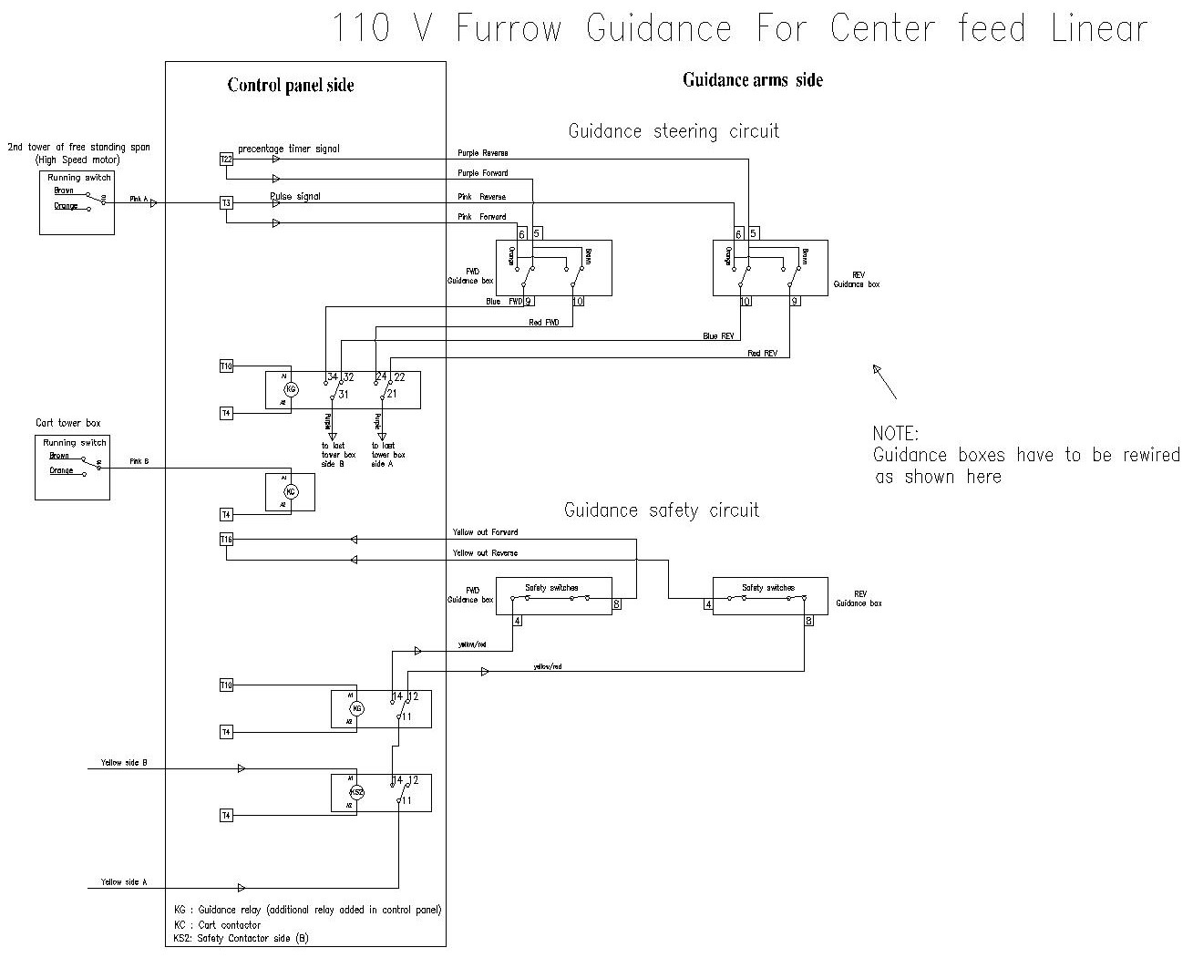

Slide 58
Reverse Guidance Box
Add small Contactor KS₂

Slide 59
Same Guidance Logic

Slide 60
Same Guidance Logic

Slide 61
Add Contactor KC to power cart motor(s).
_{(Tower box contactor not used)}

Slide 62
ABOVE GROUND CABLE GUIDANCE

Slide 63
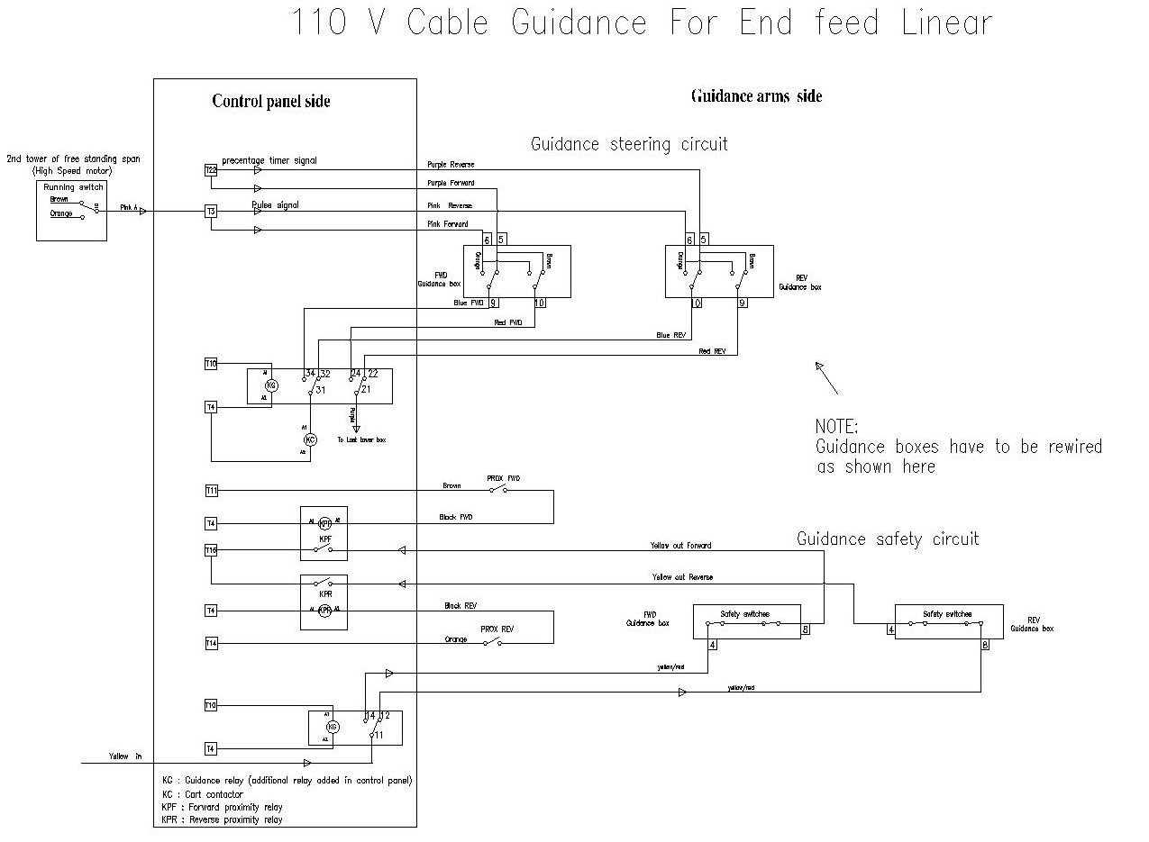
Add Proximity switch on each Arm. (110V AC)
Add 2 relays

Slide 64
AUTO STOP
(AUTO REVERSE not Available)

Slide 65
DANGER!!! AutoReverse

Slide 66
Free Cable
Auto Stop only

Slide 67
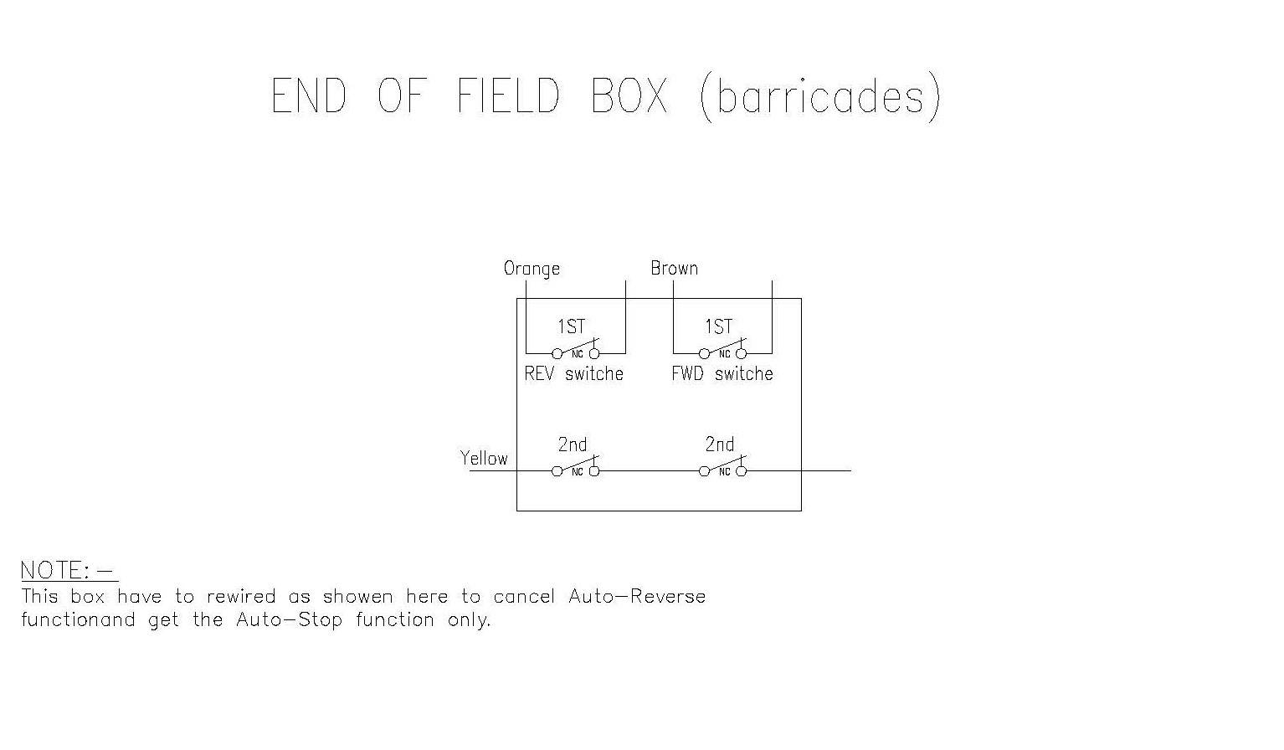

Slide 68
Last Tower
Cart
Guidance logic
Guidance Safety

Slide 69

THANK YOU

